Slide 1

Abstract Writing Tips
Understanding of the Problem
Most Challenging aspect of the problem
Reason for Choosing this problem
TIP
Be articulate and explain your understanding. Each team could look at addressing a different element of the problem.
What aspect of the problem you are going to address ?
Notes:
Understanding of the Problem
Have you got the gist?
Do not copy paste from Use Cases. ( We have written them ☺)
What have you understood after thinking deeply. What different aspects have you uncovered for the problem
Most Challenging aspect of the problem
Each problem has a key technical challenging element.
For e.g. For Predicting Queue Wait-time, it is not about building a beautiful app but about identifying and measuring parameters
Reason for Choosing this problem
We are not seeking a social perspective. Technical reasons appreciated

Slide 2
Abstract Writing Tips
Understanding of the Problem (Example)
What is it that you are trying to Solve or what particular aspect of the Problem are you going to solve
For Eg. In the Predict Queue Wait time challenge, whatever solution you will build you will communicate the wait time to people standing in Queue so that customer unhappiness is minimized.
Think Deeply about the Problem Statement and the Outcome which your solution is intended to achieve.
Notes:
Understanding of the Problem
Have you got the gist?
Do not copy paste from Use Cases. ( We have written them ☺)
What have you understood after thinking deeply. What different aspects have you uncovered for the problem
Most Challenging aspect of the problem
Each problem has a key technical challenging element.
For e.g. For Predicting Queue Wait-time, it is not about building a beautiful app but about identifying and measuring parameters
Reason for Choosing this problem
We are not seeking a social perspective. Technical reasons appreciated

Slide 3
Example :DOs
Most Challenging Aspect (Example)
Like in case of JD and Resume match problem , parsing of Timeperiods with skills and storing it in database is most challenging
Notes:
Understanding of the Problem
Have you got the gist?
Do not copy paste from Use Cases. ( We have written them ☺)
What have you understood after thinking deeply. What different aspects have you uncovered for the problem
Most Challenging aspect of the problem
Each problem has a key technical challenging element.
For e.g. For Predicting Queue Wait-time, it is not about building a beautiful app but about identifying and measuring parameters
Reason for Choosing this problem
We are not seeking a social perspective. Technical reasons appreciated

Slide 4
Example :DONTs
Reason for Choosing Problem (Example)
Don’t give General GYAAN and a Story around the Problem Statement.
State what was it that attracted you to choose a particular Problem Statement from the rest.
What was the Technical Aspect which made you choose a particular Problem Statement
Notes:
Understanding of the Problem
Have you got the gist?
Do not copy paste from Use Cases. ( We have written them ☺)
What have you understood after thinking deeply. What different aspects have you uncovered for the problem
Most Challenging aspect of the problem
Each problem has a key technical challenging element.
For e.g. For Predicting Queue Wait-time, it is not about building a beautiful app but about identifying and measuring parameters
Reason for Choosing this problem
We are not seeking a social perspective. Technical reasons appreciated

Slide 5
Abstract Writing Tips
Approach
Platform/Coding Language/Framework
External Tools
Fortnightly targets
TIP
Use Simple Diagrams.
Add Details
Give your timelines a thought. Factor in exam breaks.
Notes:
Approach
What is your idea of the solution? Use Diagrams to save words and time
Platform/Coding Language/Framework
Tech Stack, Clarity in understanding what is needed.
External Tools
If you plan to use any ready tools
Fortnightly targets
Do not ignore this aspect. We want to know if you have thought through the timelines

Slide 6
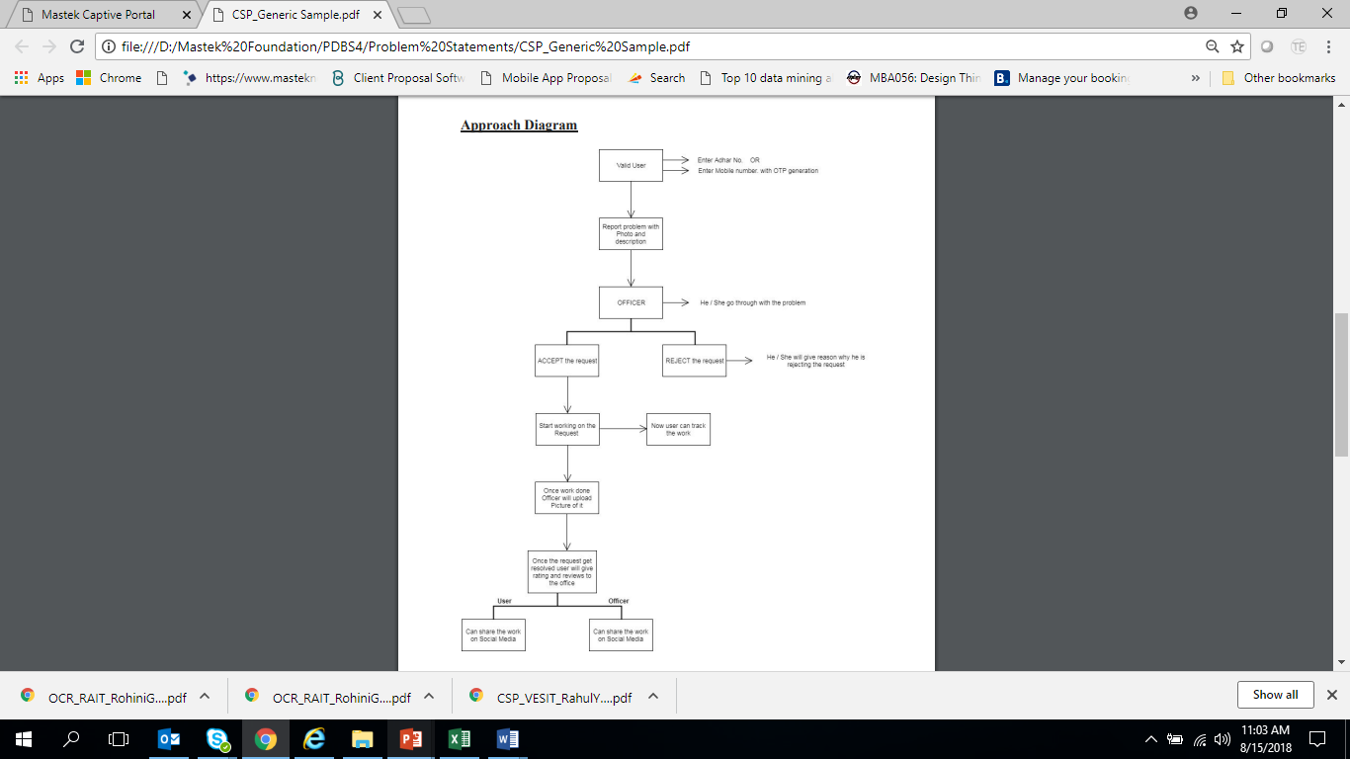
Example :DONTs
Notes:
Approach
What is your idea of the solution? Use Diagrams to save words and time
Platform/Coding Language/Framework
Tech Stack, Clarity in understanding what is needed.
External Tools
If you plan to use any ready tools
Fortnightly targets
Do not ignore this aspect. We want to know if you have thought through the timelines

Slide 7
Abstract Writing Tips
Previous Projects Undertaken
Team Strengths
Team Achievements
Personal Motivations
TIP
Previous Projects could be curricular or other hackathons / pet tech projects
Technical expertise /achievements might be of individuals and not as this team together
Do share what you are looking forward to learn
Notes:
Previous Projects Undertaken
Technical experience, participation in hackathons
Team Strengths
List individual strengths. How is everyone going to contribute.
Team Achievements
Could be a combination of individual achievements on various forums
Experience in sports and cultural activities not relevant
Personal Motivations
What are you looking for while participating

Slide 8
Example : DON’T’s
We have not done any big project we are ### student so we have just done our final year project which we have written above by doing this project we would like to prove our self.
Instead of marginalizing your own work, highlight what you have done.
We understand all teams will not be very experienced!!!!
Notes:
Previous Projects Undertaken
Technical experience, participation in hackathons
Team Strengths
List individual strengths. How is everyone going to contribute.
Team Achievements
Could be a combination of individual achievements on various forums
Experience in sports and cultural activities not relevant
Personal Motivations
What are you looking for while participating

Slide 9
Abstract Writing Tips
General TIPs
Think, research, work on your idea/ abstract.
Do not make it a hasty last-minute job, it shows
DO NOT copy paste from internet. If you are planning to use a paper etc refer it.
Early Field work might be productive to give ideas for some problems. Mention it if you do with pictures.
Highest Weightage to understanding of problem and depth of approach, but other responses matter.
Notes:
Previous Projects Undertaken
Technical experience, participation in hackathons
Team Strengths
List individual strengths. How is everyone going to contribute.
Team Achievements
Could be a combination of individual achievements on various forums
Experience in sports and cultural activities not relevant
Personal Motivations
What are you looking for while participating

Slide 10
Thank You
Notes:
Previous Projects Undertaken
Technical experience, participation in hackathons
Team Strengths
List individual strengths. How is everyone going to contribute.
Team Achievements
Could be a combination of individual achievements on various forums
Experience in sports and cultural activities not relevant
Personal Motivations
What are you looking for while participating

